Slide 1

CS660 Group 9 Project
Michael Karaman, Alexys Lamkin, Yiyun Zhang

Slide 2
Problem
Homework 2b – Pagerank
Homework run in Google Colab
MRJob run locally
Performance improvement with additional nodes

Slide 3
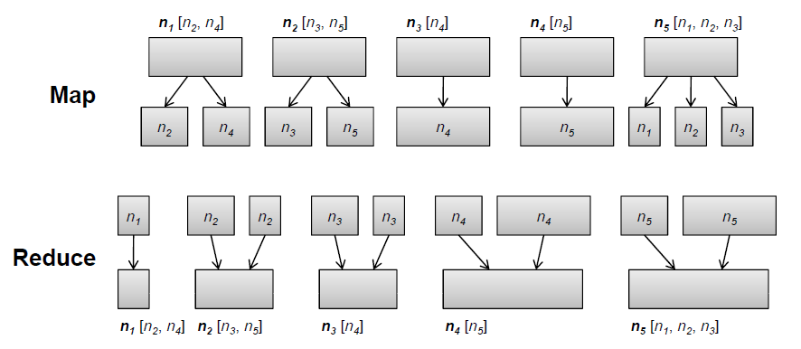
Algorithm
BFS algorithm for generating a web link graph
MRJob for single iteration of Pagerank
Helper program to iteration MRJob

Slide 4
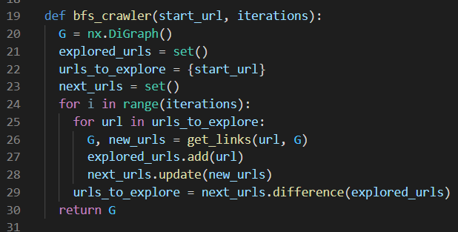
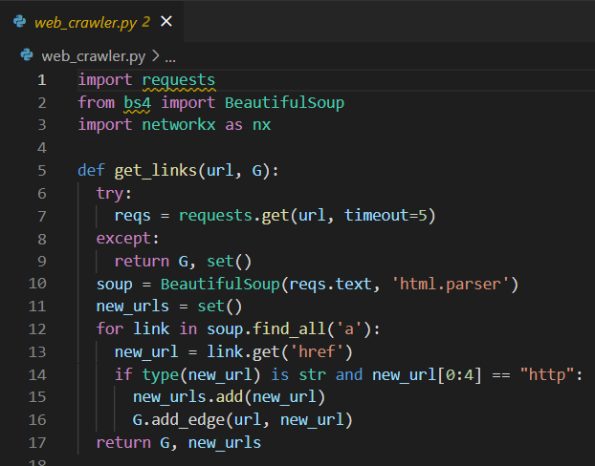
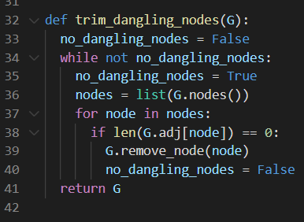
Implementation – Web Crawler

Slide 5
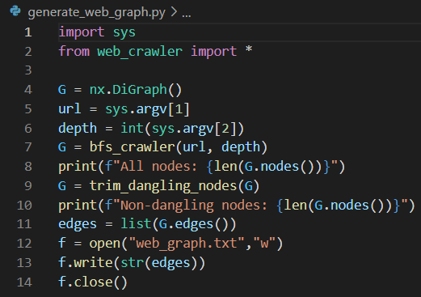
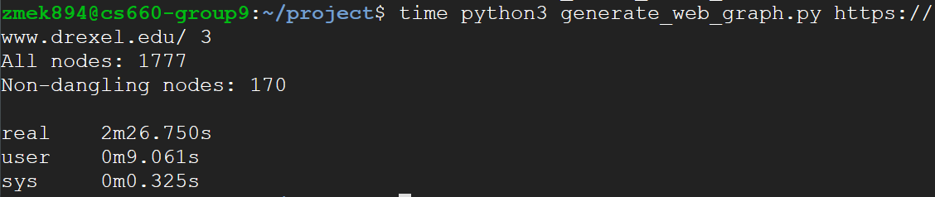
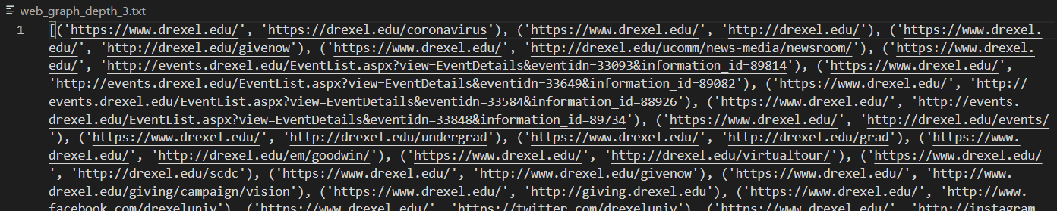
Implementation – Web Crawler

Slide 6
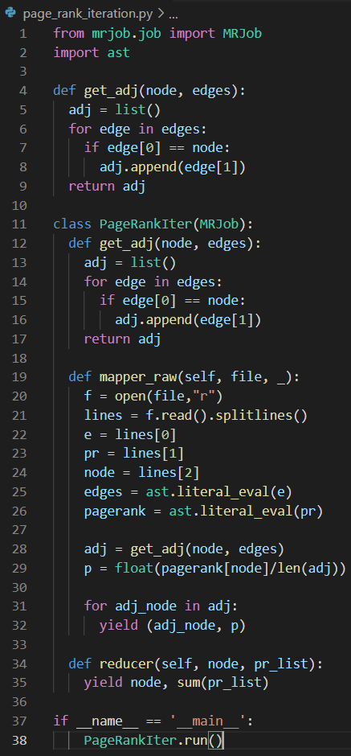
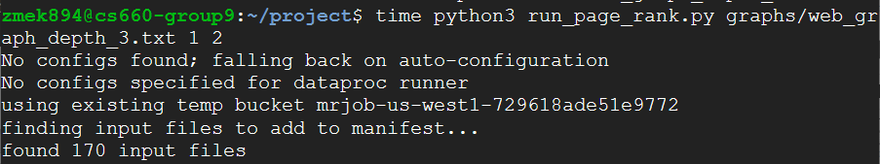
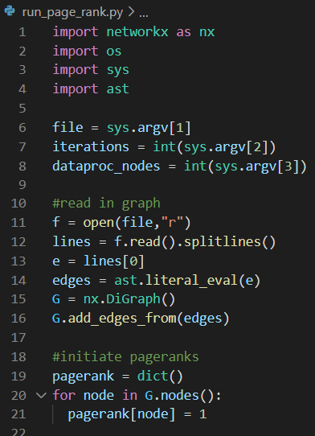
Implementation - Pagerank

Slide 7
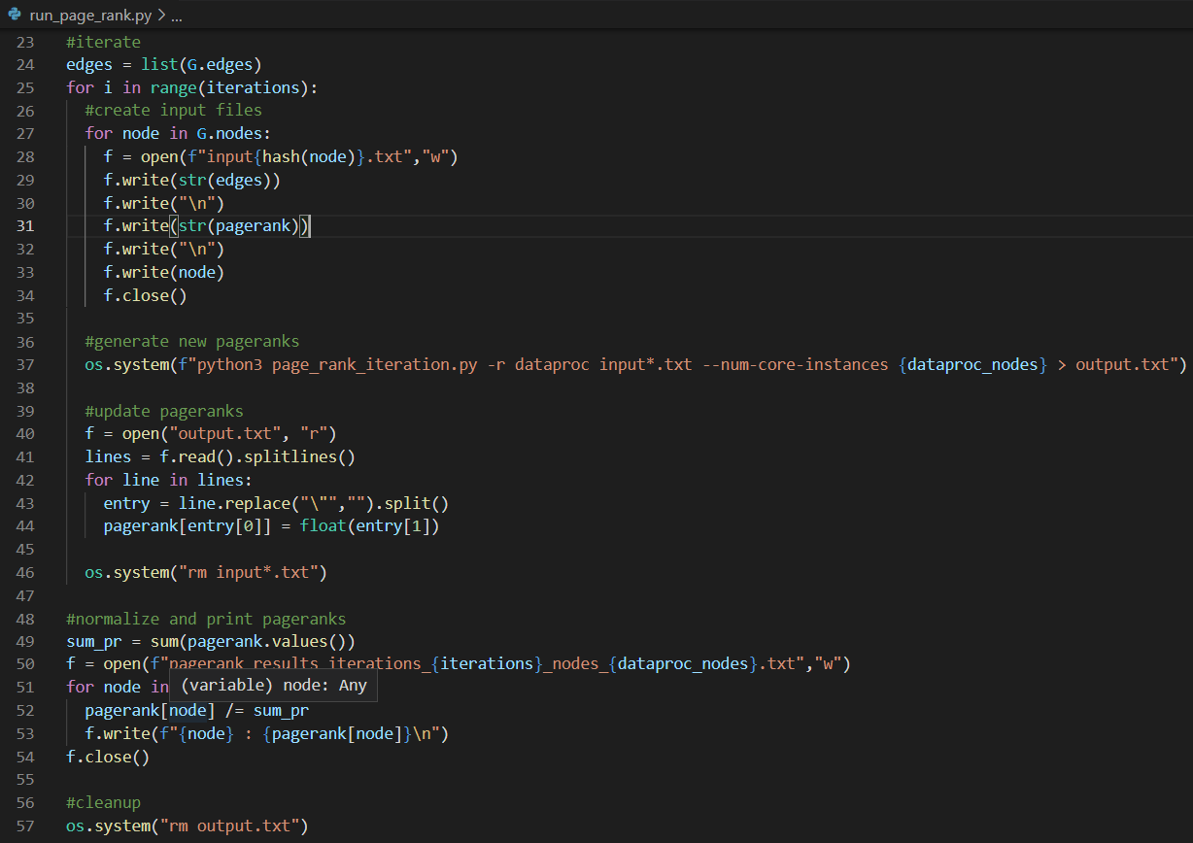
Implementation - Pagerank

Slide 8
Performance and Conclusions
n | 170
Nodes | Time
2 | 21:17
4 | 12:28
6 | 10:42
8 | 9:15
10 | 8:02
19 | 8:18

Slide 9
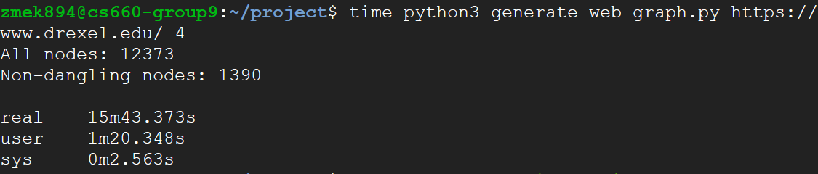
Observations and Future Work
Only 1 iteration – 5 min dataproc startup
Set up permanent nodes
MRJob compatible with Networkx, Dataproc is not
MRJob version of BFS web crawler

Slide 10
Thank You!

Slide 11
Graph Creation

Slide 12
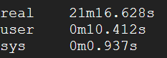
3 depth 2 nodes

Slide 13
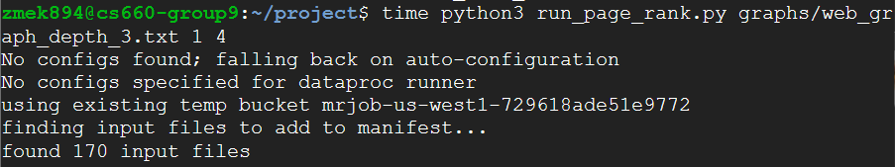
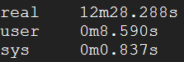
3 depth 4 nodes

Slide 14

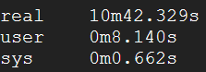
3 depth 6 nodes

Slide 15
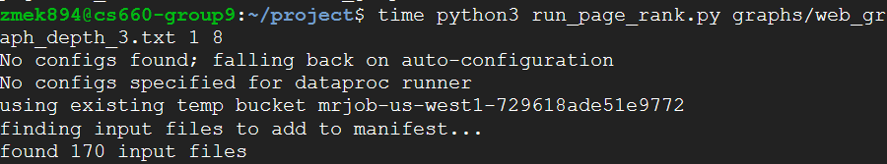
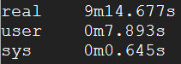
3 depth 8 nodes

Slide 16
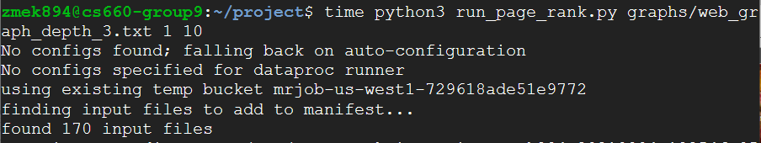
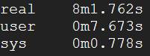
3 depth 10 node

Slide 17

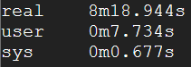
3 depth 19 node

